Slide 1

ADVANCED SHOPPING CART
Prepared By-:
GAGAN MANI {20BCS5700}
DEVANSH RAHEJA {20BCS5688}
JATIN RAWAL {20BCS5676}
SHIVANSH RAHEJA {20BCS5687}
Project Teacher
ER. SHALINI KUMARI
{E10593}
DISCOVER . LEARN . EMPOWER

Slide 2
Introduction To Project
THIS PROJECT COVERS ALL THE STANDARDS A PROSPEROUS E-COMMERCE SITE’S CART HOLDS.
FURTHER, IT FULFILLS ALL THE REQUIREMENTS LAID DOWN BY OUR INSTITUITION IN ORDER TO MAKE THIS PROJECT.
WE HAVE USED THE COMBINED KNOWLEDGE OF WEB DEVELOPMENT AND DBMS TO COMPLETE THIS PROJECT.
IN ADDITION TO THIS , WE HAVE USED THE BASIC KNOWLEDGE OF PHP,HTML AND MYSQL TO SUCCESSFULLY BUILD THIS PROJECT.
WE HAVE ALSO USED SEVERAL SOFTWARES SUCH AS XAMPP SERVER,VS CODE AND MYSQL ADMIN.

Slide 3
Problem Statement
TO DEMONSTRATE THE WORKING OF SHOPPING CART USING PHP,HTML AND SQL LANGUAGE, IT SHOULD ALSO HAVE AN APPEALING FRONT END AND A SUMMARISED BACK END.
ADD SOME INNOVATIONS FROM YOUR SIDE WHICH SHOULD ADD UP TO OUR PROJECT AS A MERIT.

Slide 4
Project Objectives
THIS PROJECT DEALS WITH THE DAILY INTERACTION OF PEOPLE WITH DIFFERENT E-COMMERCE WEBSITES.
IT CONSIST OF A WORKING WEBPAGE THAT ILLUSTRATES THE WORKING OF DIGITAL CARTS ACROSS DIFFERENT PLATFORMS.
FURTHER, THE MAIN OBJECTIVE OF OUR PROJECT IS TO DELIVER THE SAME AMOUNT OF EXPERIENCE AND FUNCTIONING TO THE PEOPLE THAT TOO JUST ON A CLICK AND WITH A BETTER USER INTERFACE.

Slide 5
Individual Contribution
NAME OF THE MEMBER | UID OF THE MEMBER | FILE/FILES PREPARED | FIELD OF WORK
GAGAN MANI | 20BCS5700 | HEADER.PHP FOOTER.PHP | FRONT-END
DEVANSH RAHEJA | 20BCS5688 | CART.PHP | FRONT-END
JATIN RAWAL | 20BCS5676 | CREATE.C.PHP | BACK-END
SHIVANSH RAHEJA | 20BCS5687 | COMPONENT. PHP | BACK-END
IN ADDITION TO THIS EVERYONE HAS INDIVIDUALLY CONTRIBUTED TO THE MAIN FILES-:INDEX.PHP AND STYLE.CSS

Slide 6
Tools Platforms/Technology/Languages Used
Xampp server-: for hosting as well as for making the connections with the back-end.
Php-:we have used this language for better flexibility as well as for efficient connections with the sql server.
Html/css-: we have used the basic knowledge of this in order to make a user-friendly site for the users.
Vs code-: we have used this software for debugging as well as for its variable compilation property.

Slide 7
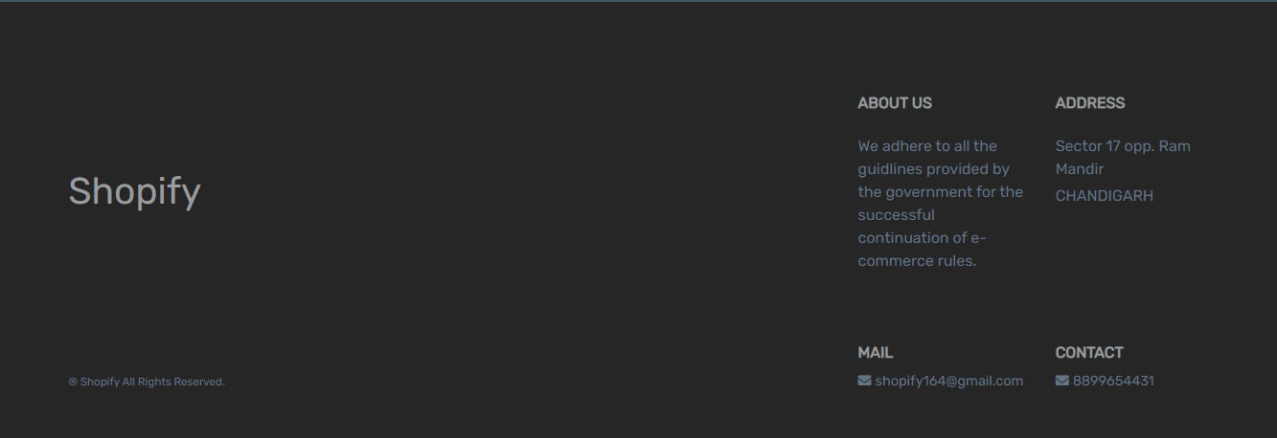
Implementation
HEADER PART OF OUR SITE-:
FOOTER PART OF OUR SITE-:

Slide 8
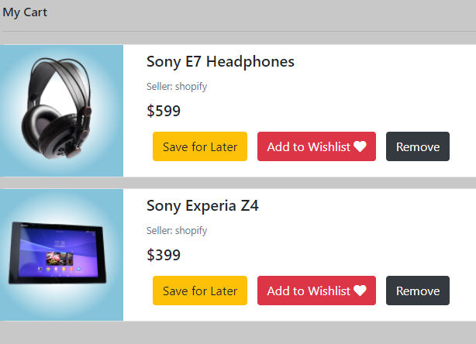
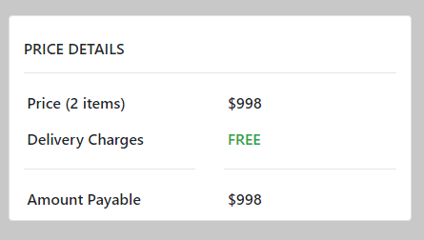
CART PART OF OUR SITE-:

Slide 9
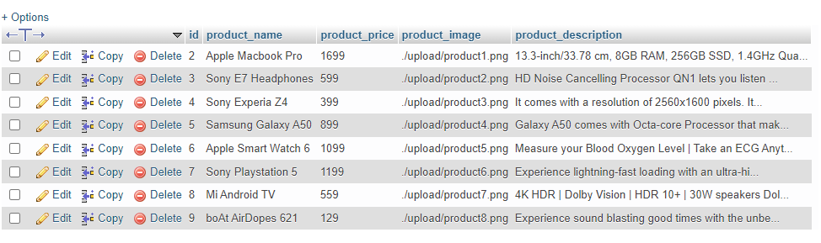
DATABASE USED FOR OUR SITE-:

Slide 10
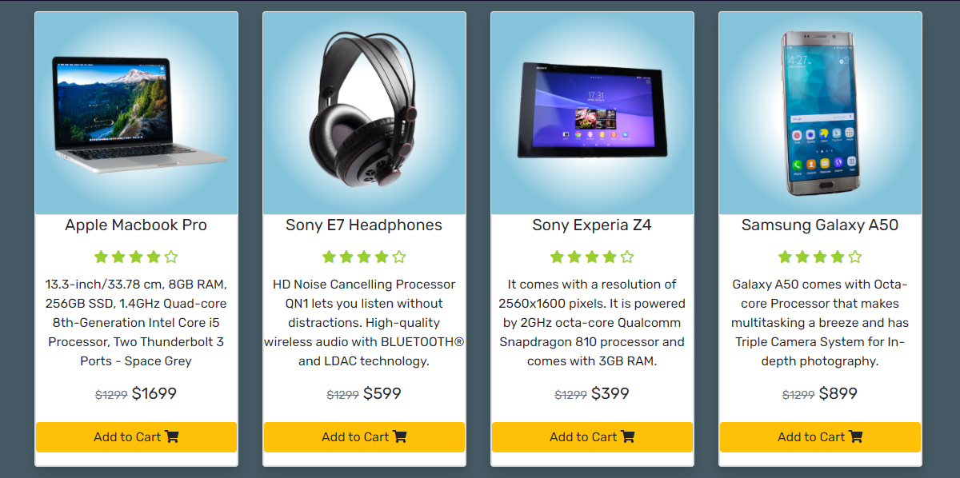
COMPONENT PROPERTIES OF OUR STE-:

Slide 11
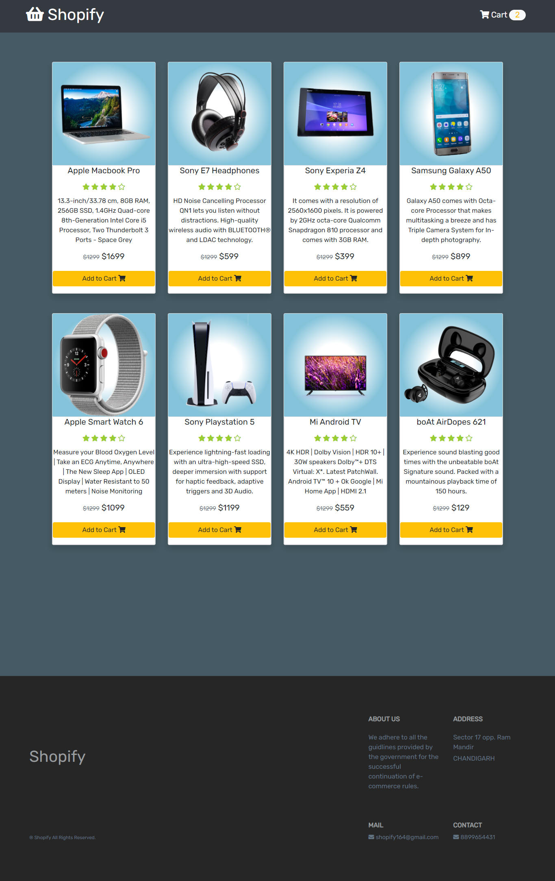
HOME PAGE OF OUR SITE-:

Slide 12
References
https://www.apachefriends.org/
https://code.visualstudio.com/
https://github.com/akashyap2013/Advance_Shopping_cart/
https://www.youtube.com/channel/UCrG2Z0usOCCdUTAr4D1A8mw
https://cdnjs.cloudflare.com/ajax/libs/font-awesome/5.8.2/css/all.css
https://stackpath.bootstrapcdn.com/bootstrap/4.3.1/css/bootstrap.min.css

